Slide 1

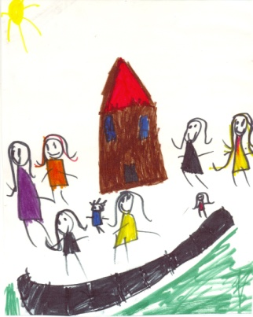

Introduction to the
North and West Children’s Resource Program
The North and West Children’s Resource Program would like to acknowledge the Traditional Owners of the lands & waters we live, work and play on. We pay our respects to all Elders past and present and acknowledge that these lands were never ceded. We welcome/celebrate diversity and inclusion of the LGBTQI+ community.

Slide 2

Children’s Acknowledgement of Country
Here is the land,
here is the sky.
Here are my friends,
and here am I.
We thank the Kulin nation for the land on which we play.
Hands up, hands down,
we are on Boon Wurrung land today.

Slide 3

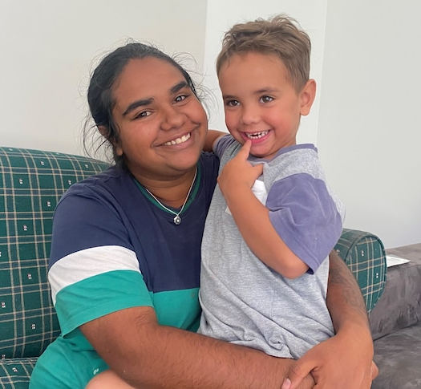

Statewide Children’s Resource Program
SCRP was developed in recognition that accompanied children formed a large cohort with an adult focus Specialist Homelessness Services (SHS) and family violence services. The ongoing work of the SCRP is to support capacity building and continue to promote and encourage best practices when responding to infants, children and young people who experience homelessness/or family violence, to ensure that children receive the assessment, support, and care essential to their safety and well-being.
Our Philosophy:
“The SCRP advocates on behalf of children and young people in the homelessness and family violence sectors. We uphold the rights of children as stated in the United Nations Convention on the Rights of the Child”.

Slide 4

Children and Homelessness Statistics
Please watch the Youtube video here
This video was produced by the Statewide Childrens Resource program which provides a brief overview of the latest statistics regarding children accessing Homelessness Services published in the 2021-2022 Australian Census.

Slide 5
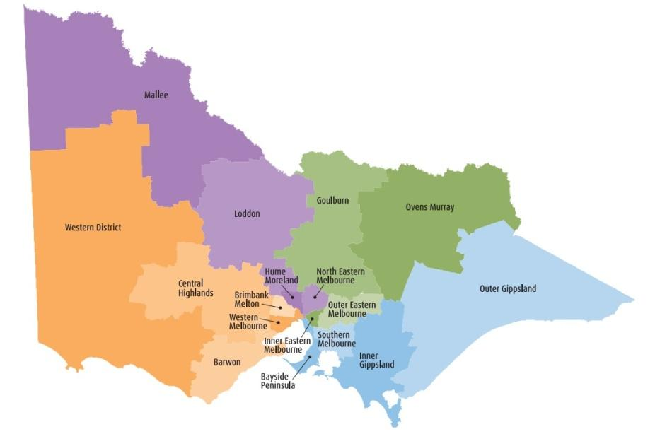
Statewide Children’s Resource Program

Slide 6

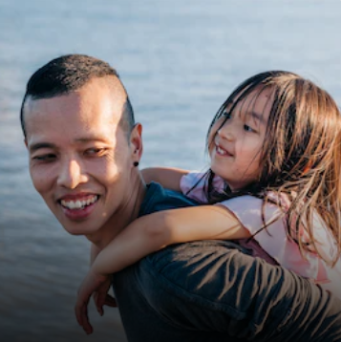
All Children:
Require a safe, secure and nurturing environment to promote positive childhood experiences and physical and emotional growth
Require predictable and responsive caregiving
Aboriginal children need to be connected to culture and community
Should have access to quality, affordable education
Should be encouraged to dream about their futures by being creative and foster a sense of belonging within family and community
Quote:
“Responsibility is fostered by allowing children a voice and wherever indicated a choice in matters that affect them."
- Haim G Ginott

Slide 7

What are the objectives of the program?
The objective of the program is to ensure children are seen as clients in their own rights. We provide resources, training and secondary consultation for practitioners to upskill their knowledge and practice to work effectively with children.
The role of the SCRP is flexible and can meet specific regional needs that are identified within the program’s core functions, these being:

Slide 8



Statewide Children’s Resource Coordinator Core Functions:
STATEWIDE CHILDREN’S RESOURCE PROGRAM
Direct Support to Homelessness Services
Secondary Consultations
Training and Development
Service System Development

Slide 9
Statewide Children’s Resource Coordinators:
Hume, Moreland & North Eastern Melbourne - 03 9359 5493
Brimbank Melton & Western Melbourne - 03 9359 5493
Goulburn Ovens Murray Areas - 02 6043 7400 or 0458 010 923
Loddon and Mallee Areas - 0407 839 708
Inner/Outer Eastern Melbourne - 03 8870 4042
Inner/Outer Gippsland Areas - 03 5144 7777
Central Highlands & Wimmera North West Areas – 0466 474 192
Barwon & Wimmera South West Areas - 03 5232 5231
Southern Melbourne –
Bayside Peninsula Areas - 0427 451 571

Slide 10
North and West Children’s Resource Program:
Hume, Moreland & North Eastern Melbourne - 03 9359 5493
Brimbank Melton & Western Melbourne - 03 9359 5493
Halime and Clare
NWRCRP@merri.org.au

Slide 11

Thank You…
“There can be no keener revelation of
a society’s soul than the way in which it treats its children.”
Nelson Mandela
“Children are mirrors, they
reflect back to us all we say and do.”
Pam Leo

