Slide 1

Implementation of Crisis in Crisis II: The Way Forward
How did we get here?

Slide 2
Consumer survey 2017: Findings
2017 Consumer Survey: Findings
 | Average safety score Overall | Average safety score Males | Average safety score Females | Trans safety score (1 respondent)
Caravan Park | 34% | 33% | 41% | NA
Crisis facility like Flagstaff, Southbank or Ozanam House | 66% | 66% | 97% | 80%
Hostel | 36% | 37% | 34% | 50%
Hotel | 46% | 54% | 39% | 94%
Motel | 48% | 49% | 47% | 51%
Refuge | 72% | 67% | 81% | 100%
Rooming or Boarding House | 33% | 34% | 35% | 100%
Table 16: Perceptions of safety by accommodation type
If you have ever stayed in any of these places, how safe did you feel? (Score out of 100)
0 = I was terrified (0%), 1 = Unsafe (25%), 2 = It was okay (50%), 3 = Safe (75%), 4 = I felt very safe (100%)
In caravan parks, hostels, hotels and rooming houses, consumers rated they felt unsafe to below OK.

Slide 3
2017 Consumer Survey: Findings continued
20. What would your ideal sort of emergency or crisis accommodation be like?
Major themes for female respondents
A home (permanency)
Safe & secure
Clean
Appropriate for children
Spacious and private
Private
Good facilities – kitchen
Supported
Major themes for male respondents
Affordable
Own space and private
Safe & secure
Supported
Less restrictive (on accessing crisis accom, on length of stay, gender specific)

Slide 4
If you had the choice would you prefer your own self-contained space (even if it was very small) or would you prefer living with others with support on site?
 | Living in my own contained space | Living with others with support on-site | No response
Both Genders | 123 (85%) | 22 (15%) | 18
Male (% males) | 57 (78%) | 16 (22%) | 2 (4%)
Female (% females) | 64 (89%) | 8 (11%) | 4 (5%)

Slide 5
2017 HEF findings
HEF spend on emergency accommodation 2017: Melbourne's north and west
Accommodation | Total HEF $s 2017 | Total HEF assists 2017 | Average cost per assist
The Palms | $488,960 | 3090 | $158.24
Parkside Inn | $273,219 | 610 | $447.90
WEST CITY MOTEL | $268,336 | 822 | $326.44
Coburg Motor Inn | $224,004 | 691 | $324.17
SLM/Northwestern Accom | $185,050 | 687 | $269.36
Stay Inn | $144,492 | 697 | $207.31
MONTE NILLA MOTOR INN | $116,005 | 328 | $353.67
Best Western Mahoney's Motor Inn | $82,675 | 183 | $451.78
Park Squire Motor Inn | $71,261 | 72 | $989.74
City East Motel | $70,542 | 99 | $712.55
Nicos backpackers | $40,062 | 209 | $191.68
Footscray Motor Inn | $37,609 | 81 | $464.31
Hume Villa Motor Inn | $34,633 | 77 | $449.78
William T Onus | $28,040 | 118 | $237.63
Bell City | $22,645 | 61 | $371.23
Hostel + Collingwood | $21,445 | 75 | $285.94
Redan Apartments | $21,128 | 74 | $285.51
Greensborough Comfort Inn | $20,830 | 45 | $462.89

Slide 6
2018/19 Rating scale development
Across the NWLASNs top 40 in 2018-19, 40% of all HEF went to private providers rated overall at 1.0 (‘Does not meet expectations’) at a total cost of $909,385, this represented 54% of all assists to purchased emergency accommodation.
Just 7% of HEF went to providers rated at 3.0 (‘Meets expectations), representing less than 3.4% of all assists.

Slide 7
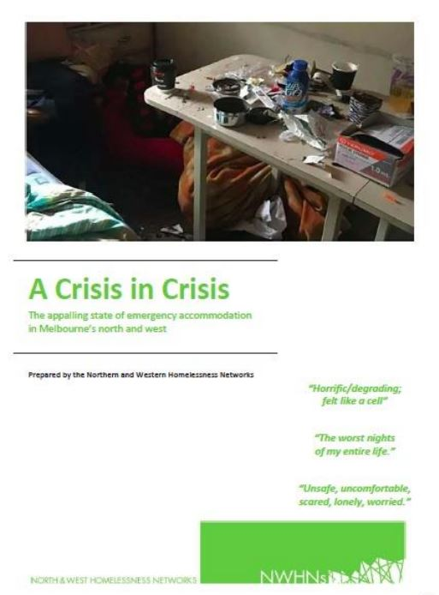
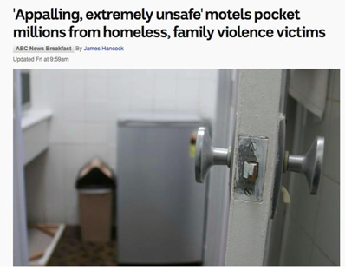
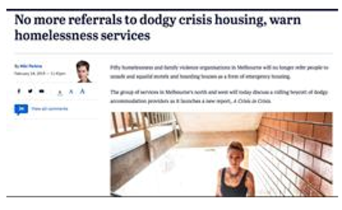
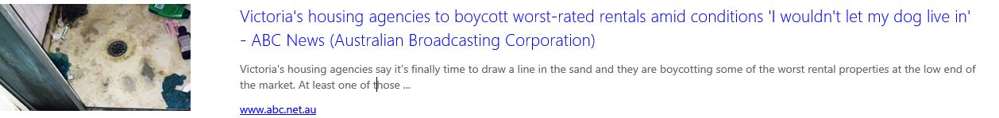
2019 Crisis in Crisis: Report
Notes:
In February 2019 the Northern and Western LASNs endorsed the Crisis in Crisis Report, which was launched publicly. Statements of support from around the State.
Statewide support for the report – VHN picked up the issue as its primary advocacy activity.

Slide 8
Embargo
From 1st March 2020 the Northern and Western Homelessness Networks boycotted one of the private accommodation providers, variously known as SLM, DS Leasing, North West Accommodation and McDON.
Preparation for the boycott included correspondence and meetings with: Department of Justice, Local Councils, development of a frequently asked questions document, a stakeholder information sheet and circulation of an information sheet to members of Parliament.
In 2018/19 year, the homelessness sector in the North and West referred 1,426 people to rooming houses. Nearly 50% of these referrals (649 or approximately 12 a week) were to rooming houses that we are now boycotting. (I believe that this covers about 35 rooming houses.)
Since the boycott, the number of private rooming houses in Brimbank has dropped by 12.

Slide 9
2019/20 Crisis Accommodation Options Project
Funded by DFFH, in response to Crisis in Crisis
2 project workers for 12 months
190 page report
Context
Context: Housing Establishment Funds (HEF)
Context: Crisis Supported Accommodation (CSA) Facilities
Context: Demand vs Capacity
Project Findings Pre-Pandemic
Mapping of Existing Crisis Accommodation Options
Exploration of New Options
Outcomes and Support Pathways for those Assisted with HEF
Changes to the System during COVID-19
Emergency Accommodation Responses During the Pandemic Period: Accommodation Options Mapping
Emergency Accommodation Responses During the Pandemic: Demographic Data
Motel Use during the Pandemic Period: The Client Experience
Motel Use during the Pandemic Period: Feedback from IAP Staff and Coordinators
Motel Use during the Pandemic Period: Feedback from Providers
Further Feedback from IAP Workers and Coordinators on Pandemic Period EA Response (IAP Motel Use Survey)
Key Findings from the Pandemic Period: What did changes in response to the pandemic teach us about the current model?
The End of the Pandemic Response
Looking Toward Alternatives
The wider Australian context: reviewing crisis accommodation responses in other jurisdictions.
An example from further afield: Ireland
A local alternative: the McAuley House Essendon proposal

Slide 10
CAOP findings
The response to the pandemic showed us that changes to the current system have the potential to ameliorate some of the trauma experienced by people who are placed in emergency accommodation. One of the most significant examples of this was the establishment of the Hotel Emergency Response, which involved the placement of support, health and security staff onsite in high use hotels. This was identified by consumers, support workers and hoteliers as a significant improvement to the safety and responsiveness of this accommodation.
Increasingly families are provided with a more comprehensive response to facilitate successful housing outcomes beyond temporary accommodation. Many single-person households repeatedly churning through the system without a meaningful resolution to their lack of housing.
In line with the Guidelines, services are often forced to prioritise HEF assistance to those deemed most likely to achieve a housing outcome. This disadvantages single-person households, who frequently cannot even enter the system on the basis that they are unlikely to be able to access a longer term support or housing outcome.
The Sector lacks detailed information on the private options it uses, with significant divergence of perceived quality and suitability across services.
By the Sector’s own rating system, the vast majority of the accommodation purchased with HEF is considered ‘inappropriate and unsafe’ accommodation.

Slide 11
CAOP Findings continued
The possibility of rapidly repurposing existing properties for use as crisis supported accommodation has been demonstrated in the establishment of the COVID Isolation Recovery Facility (CIRF) facilities during the pandemic - with the support of government, there are likely to be further opportunities to utilise existing residential or commercial properties in the aftermath of the pandemic.
The response to the pandemic showed us that changes to the current system have the potential to ameliorate some of the trauma experienced by people who are placed in emergency accommodation. One of the most significant examples of this was the establishment of the Hotel Emergency Response, which involved the placement of support, health and security staff onsite in high use hotels. This was identified by consumers, support workers and hoteliers as a significant improvement to the safety and responsiveness of this accommodation.
Even with this significant investment and the investment of the historic Housing Big Build, the provision of emergency accommodation will always be required as part of the ongoing system response. Overall, the Crisis Accommodation Options Project has reinforced the final conclusions of the Crisis in Crisis report:
* it is unrealistic to expect a private, for profit Sector to appropriately respond to the needs of those in crisis and that the Sector’s reliance on low end accommodation, which is rated as ‘inappropriate and unsafe’, is exacerbating the trauma experienced by consumers; and that
* provision of emergency accommodation, particularly in the absence of sufficient support capacity, contributes to ‘churn’ amongst those experiencing homelessness and is not contributing the achievement of appropriate long-term housing outcomes.

Slide 12
CAOP Recommendations
24 recommendations/4 key recommendations that the Sector can lead:
  Rec 5: That, in any update to the HEF Guidelines, the Department include a definitive statement regarding the use of HEF for accommodation that is appropriate to varying client need, including clear definitions, using the rating scale, of what is considered appropriate.
  Rec 9: That the Department resourcing be provided to enable comprehensive implementation of the rating system for private accommodation providers (see Recommendation 10).
  Practice principles for application of the rating system would include:
    That resourcing enables assessment of any potential new providers against the rating scale.
    That accommodation purchased by services within the NWLASNs aims to meet a rating of 3 (‘Meets expectations’).
    That services within the NWLASNs agree to cease referral of households to private accommodation providers with a rating of 1 (‘Does not meet expectations’).
    That the required increase to the allocation of HEF takes into account the higher cost of purchasing better quality accommodation (see Recommendation 2).
  Rec 13:That NWLASNs’ Access Points cease the use of private rooming houses as a purchased accommodation option unless they meet a rating of 3. Clients residing in these rooming houses are to be offered proactive support to help them find alternate accommodation.
  Rec 22:That the Sector and Department prioritise the procurement of emergency accommodation options with self-contained facilities.

Slide 13
Implementation of recommendations
Northern and Western LASNs signed off recommendations in December 2020.
Report sent to DFFH January 2021
Crisis in Crisis Working Group drafted implementation options
LASNs considered options in August 21
Crisis in Crisis Working Group developed vision statement to identify LASNs’ aspirations.
Joint LASN meeting: LASNs to plan implementation priorities and strategies.

Slide 14
Pre Implementation activities
How can the LASNs move toward implementation in a manageable way?
The Crisis in Crisis Working Group recommends four pre implementation activities:
Further development and implementation of a rating scale
How can we implement a rating scale?
A consumer survey to explore the consumer perspective on crisis accommodation options
What do we want to know from consumers that will assist our decision making?
Documentation of the barriers to implementation
How do we explore and address these barriers?
Advocacy
What do we want to advocate for?
HEF Guidelines

