Slide 1








Collaboration in the AOD, Mental Health & Homelessness sectors across Melbourne’s North & West
Making Links: Looking back, moving forward
Wednesday, 4 September 2019

Slide 2

Objectives
Objectives
Since its inception in 2015 MAKING LINKS has sought to promote effective cross-sector collaboration between the AOD, Mental Health & Homelessness sectors across Melbourne’s North & West.
As the project is now coming to an end we wish to:
Mark its passing & acknowledge everyone’s contributions
Reflect on the project’s gains & challenges
Seek your guidance on urgent needs, broader priorities & future opportunities
Notes:
Create a shared understanding of who our shared clients are and how they are accessing services
Provide an orientation to each other’s service system
Create an opportunity for collaborative problem solving in response to client and systems issues
Enable cross-sector networking
Provide an opportunity to explore how to improve service coordination for shared clients, and
Better understand the potential further change to each other’s sectors, in particular concerning:
The recent release of the Aspex review of the MHCSS and Drug Treatment Services
The forthcoming NDIS, and
Anticipated changes in the Housing & Homelessness sector.

Slide 3

A Guide to Making Links
An Overview of Making Links:
An AOD, Mental Health & Homelessness Partnership in Melbourne’s north and west
A coordinated project between AOD, Homelessness and Mental Health
Community Support Services in Melbourne’s North and West

Slide 4

What is Making Links?
A partnership between the AOD, Mental Health and Homelessness Sectors in Melbourne’s north and west
Aim: To improve coordination and linkages across the AOD, Homelessness, Mental Health and Family Violence sectors for the benefit of shared clients.
Established in 2015, following the re-commissioning of the AOD and Mental Health Sectors
New Catchment/Area Planner positions facilitated Sector coordination
All Sectors identified cross sector work as a priority
Unfunded project
Notes:
Create a shared understanding of who our shared clients are and how they are accessing services
Provide an orientation to each other’s service system
Create an opportunity for collaborative problem solving in response to client and systems issues
Enable cross-sector networking
Provide an opportunity to explore how to improve service coordination for shared clients, and
Better understand the potential further change to each other’s sectors, in particular concerning:
The recent release of the Aspex review of the MHCSS and Drug Treatment Services
The forthcoming NDIS, and
Anticipated changes in the Housing & Homelessness sector.

Slide 5
The Making Links Data Snapshot
One day data snapshot:
  # of consumers facing issues supported by the participating Sectors,
  # in receipt of support from these Sectors and
  # who might benefit from the support of all three Sectors.
235 workers completed the data
Across the three sectors, respondents
reported working with 2,275 consumers.

Slide 6
Making Links Data snapshot findings
Notes:
89% of all client reported had at least one comorbid presenting issue as well as the issue of primary concern to the service.
25% of clients presented with AOD, homelessness and mental health issues. Of them, only 30% were accessing the support of all three service systems.
Approximately twice as many people over 25 presented with multiple needs compared to those under 25. It is likely that this can at least partly be explained by the relative number of people accessing the sectors.
Findings were generally consistent across gender, although workers identified more men as having multiple needs.
89% of those people with identified homelessness who are not currently linked to homelessness services would benefit from a service
40% of people with identified mental health issues and currently serviced within another sector are linked with a mental health service
23% of people with AOD issues and currently serviced within another sector are linked with an AOD service
Only 30% of people with needs across the three sectors are linked across all three sectors
Of those with needs across all three sectors but not currently linked, respondents’ report 48% of those clients would benefit from engagement with the three sectors.

Slide 7
The Worker Survey
151 workers across the 3 Sectors completed the survey about their experiences of the other Sectors.
30% of respondents have been working for less than 2 years, 26% for between 2 and 5 years and 44% for more than 5 years
Workers commented on:
Referrals to the Mental Health Sector were experienced by both workers and clients as easiest.
Ease of referral to the AOD Sector was slightly higher than to the Homelessness Sector.
Sharing of information with the Homelessness Sector was the most straight forward.
The ability to work collaboratively was experienced equally across all three sectors with 50% partially agreeing and 25% agreeing that ongoing collaborative work has been possible.
Notes:
Intake/entry points: Most favoured single entry points; many were concerned about the length of the intake assessment and wait for a service.
Respondents felt workers in other sectors were professional and committed to good practice.
Suggestions for system improvements:
Better communication and collaboration
Regular opportunities for networking, orientation and knowledge sharing
Mechanisms for better understanding of each other’s practice and approach to client work.

Slide 8
Forum 1: Priorities for cross sector work
Co-location with a service response
Develop a common frequent service user (FSU) register and responses
Shared Practice Model
Collaborative intake assessment and service delivery
Communication/Information Sharing (collaborative practice)
Reciprocal rotations for staff into other service sectors
Brief interventions while people are on waiting lists
Collaborative approaches to clients requiring multiple supports
Opportunities for workers to gain understanding of different service sectors
Notes:
Participants built on themes from presentations about each Sector, the data and survey findings:
Systems responses/improvements
Worker knowledge/practice improvements – working better with people with AOD/Mental health/housing issues – core competencies
Working together to address demand – diversion, brief intervention
Opportunities to work together with shared clients- coordination
Shared approaches to shared clients – collaboration [Frequent service users]

Slide 9
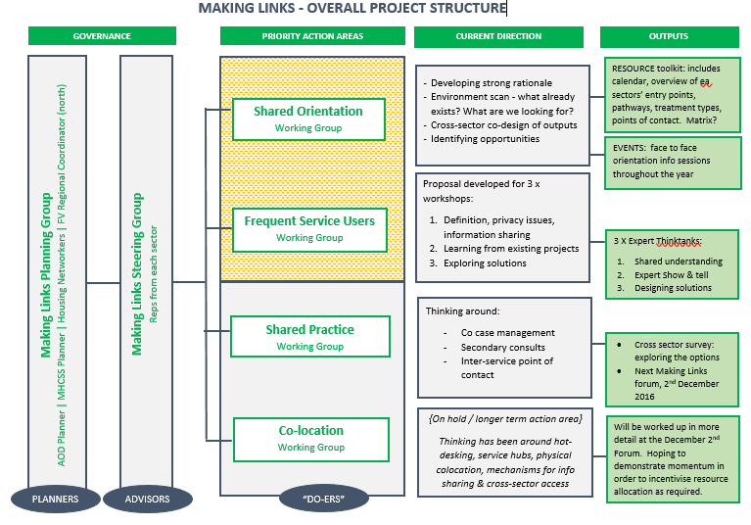
Steering Group and priority setting
Notes:
Steering Group and Working Groups established
Statement of Intent signed by all three Sectors
Orientation Working Group - to develop opportunities for sharing training, orientation and information across the three Sectors.
Frequent Service User Working Group - to consider mechanisms to improve our work with shared clients who have complex needs.
Practice Working Group – to work on case coordination, incorporating shared tools ie assessment, referral, case review.
McHub/Co location Working Group– to progress co location with a focus on exploring ease of access for clients, ease of access to information for workers, and reducing the complexity of intake and assessment processes.

Slide 10

Orientations and the Making Links Guide
First step to collaboration – improve cross sector understanding
Created a guide to the participating service systems, highlighting ‘tips and tricks’ for workers – to provide a realistic introduction to each Sector
Printed and online versions
Tested in Forum 2 – positive feedback
Learnings:
  Incredibly time consuming
  Expensive
  Useful

Slide 11
Frequent Service User Think Tanks
3 ‘think tank’ workshops over a three month period
Think tank 1: Shared understandings: Overview of collective impact approaches, worldwide literature review of FSUs, developing a shared definition of FSUs
Tank 2: Expert Show and Tell:
Presentations on MACNI, Journey to Social Inclusion, HOMHS, Launch Housing FSU project, Taskforce 1000, Privacy Commission; workshop “from learnings to design”
Think Tank 3: Designing the model:
Evidence based decision cards: What we know, and what we need to decide; development of a shared model

Slide 12
Frequent Service User Model
Outreach capacity
Secondary consult capacity
Practice model incorporates a focus on connectedness and built in worker redundancy.
Housing first & housing guarantee
Long term step up/step down support if needed – need to ensure that an alert capacity is built in with capacity to respond in a timely way as needed (ie like chronic disease management)
Establish a relationship to an agency, not a worker in the long term
Evaluation – intersect with a social return on investment practitioner or university
Part of the work of the team would be to get the client an NDIS package if they are eligible

Slide 13
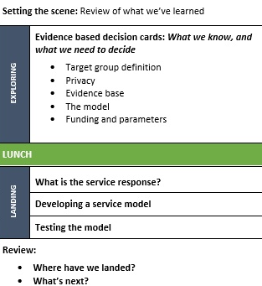
FSU: Critical success factors
Collaboration: shared vision, philosophy/core values, training, shared approach, language and culture, mechanisms to grow shared practice/coordinate and resolve issues.
Making Links has a focus on shared practice that we direct to this project.
The authorising environment is critical.
Consumer voice – build in to our evidence base: an understanding of clients, their view of impact – what the services means to them. Co design with consumers. Inclusion of a peer support worker.
Evaluation – domains/meaningful activity (connection), service model design
Openness to reflect/develop/improve
Notes:
Shared strong desire to work more effectively with people who represent frequently to services
The think tank process was rigorous, assisted in creating engagement with the issue/potential actions and shared understanding
Participation was committed and high level
Service system change is time consuming and requires resources for coordination – to facilitate the goodwill, provide a neutral voice, build the model
No capacity to write up the learnings and model design, beyond the initial funding submission – findings may be lost

Slide 14
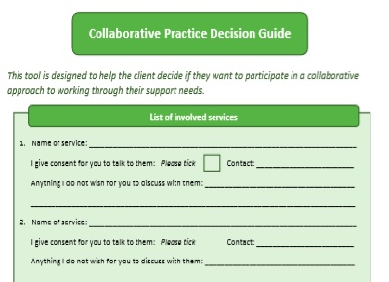
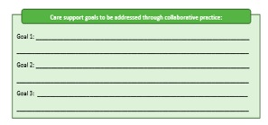
Collaborative Practice Framework
The Guide includes:
A decision-making guide to work through with consumers – assisting the client to identify if cross-sector collaboration would be useful to them, and if so, what the parameters would be.
A ‘Collaborative Practice Working Guide’ – helping inform the arrangements between providers and putting forward a list of possible solutions to the challenges which may arise.
A template for recording collaborative practice activity across sectors.
Notes:
Started to develop a framework in a Shared Practice Forum with 100 practitioners. Developed the Framework and then tested with practitioners in Orientation 1, then updated the Framework and trialled it with a small number of agencies.
Trialled with a small number of agencies

Slide 15
Collaborative Practice Learnings
Capacity for collaboration has improved in the past four years
An authorising environment and resources are necessary to adequately drive cross sector change
Co design should occur with consumers
What elements work well:
  Clarity about information sharing & roles
  Key contact/coordinator
  Cross sector networking

Slide 16
Making Links: Overall learnings
Enormous commitment and goodwill but agencies are too stretched
DHHS authorisation
Resourcing is essential ($13,000 DHHS Central)
Personalities have an impact: not everyone is built for easy collaboration
Progressing each priority was a huge undertaking – requiring working groups, workshops, reports, resources.
Planners/Networkers were too ambitious

Slide 17
What would we do differently?
More engagement with DHHS - focus was grass roots
Overly ambitious – attempting change across three Sectors; really looking at reform
Break people up into catchment areas for networking so that they could build on collaboration at forums
Choose one priority activity, rather than four
Producing resources is useful but costly

Slide 18
Thanks
Enormous thanks to the Steering Group members. Particular thanks to: Victor Bilous, Maryann Croatto, Brendan Pearl, Dean Alexander, Gordon Conochie, Caddy Purdy, Phil Watson, RDNS/Bolton Clarke
Planners/Networkers: Louise Richardson, John Quiroga, Grant Liptrot, Kate Patterson
Workshop participants
DHHS Homelessness & Accommodation Support
NWMPHN

Slide 19
Developments impacting cross-sector collaboration
There are multiple reforms & system wide developments currently underway which will have an impact on future cross-sector collaborations between AOD, Mental Health, Homelessness & other service sectors
For example :
  Royal Commission into Mental Health System (VIC)
  Parliamentary Inquiry into Homelessness (VIC)
  Family Violence (FV) reforms – e.g. introduction of Support & Safety Hubs, specialist FV courts, information sharing schemes & MARAM
  NDIS legislation review
  Implementation of VADC

Slide 20
Cross-sector aspirations
Aspirational goals for how these sectors can work together
Wouldn’t it be great if …
Ranking cross-sector priorities
Identifying urgent needs & service gaps within North & West Metro Melbourne
Ranking cross-sector priorities
Workable solutions & improvement opportunities
Suggesting collaboration opportunities & partnership activities
Consider:
Resources required
Activities
Outputs
Making Links: Looking back, moving forward
consultation

Slide 21
Making Links: Looking back, moving forward
consultation
All roundtable discussions to be held at Uniting ReGen (26 Jessie St Coburg 3058) from 1.30 – 4.00pm
Working effectively with CALD communities
Mon, 9 September
Seeking input from:
Bi-cultural workers & other practitioners in ethno-specific agencies / programs
Local govt planners & other staff
AOD practitioners
Roundtable discussions
Promoting greater levels of cross sector collaboration
Mon, 10 October
Seeking input from:
AOD practitioners
Allied health workers – Mental Health, Homelessness, Family Violence, CALD etc
Local govt planners & other staff
Enhancing pathways & entry points into AOD treatment
Thurs, 14 October

Slide 22
Service mapping & geographic demand analysis
Analysis to examine:
Current & future (i.e. projected) levels of service demand
Whether existing services are accessible, fit-for-purpose & suitably located
Whether existing resources should be reallocated (in line with upcoming boundary realignment)
Targeted consultations (individual &/or group) with consumers
Consumer engagement & consultation options currently under review. Consultations to focus on:
Consumer health literacy
Referral pathways & entry points
Help seeking behaviours
Views on treatment barriers, service gaps & opportunities for service improvement
Consultations scheduled for 2020
Catchment specific strategies targeting priority populations

Slide 23

MH, AOD and Homelessness Service Integration

Slide 24
AOD
Homelessness
Mental Health
A common agenda
A shared approach

Slide 25
Phase 1
Phase 2
Phase 3
Phase 5
Phase 4
Project Life Cycle
Mapping the landscape: identifying key services, leaders and workforces
Building connections and relationships: leverage off partnerships, networks & collaborations
Identifying shared vision and values: common goals & opportunities
Co designing shared approaches and practice, centering on lived experience
Regenerative systems: implementation, communication, sustainability and growth

Slide 27
Plan on a page

