Slide 1
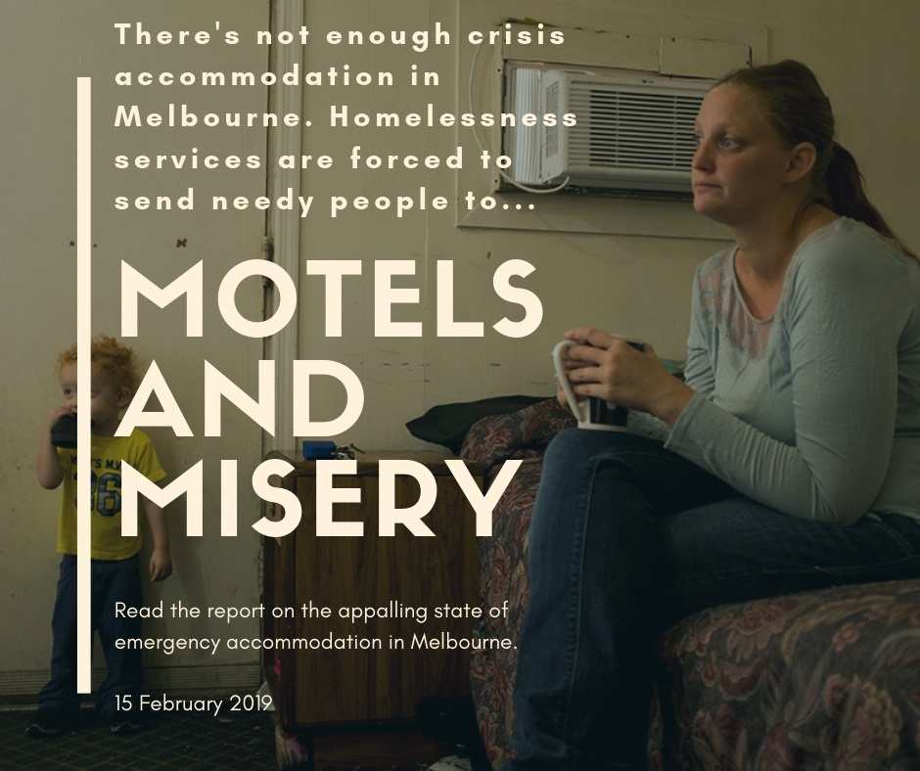

Slide 2
“nothing good where you sent me. the system is flawed. u you put me up in a motel @ $120/nt . i have been from pillar to post and treated like second class citizen. I preferred sleeping on the streets compared to where you good people sent me”

Slide 3
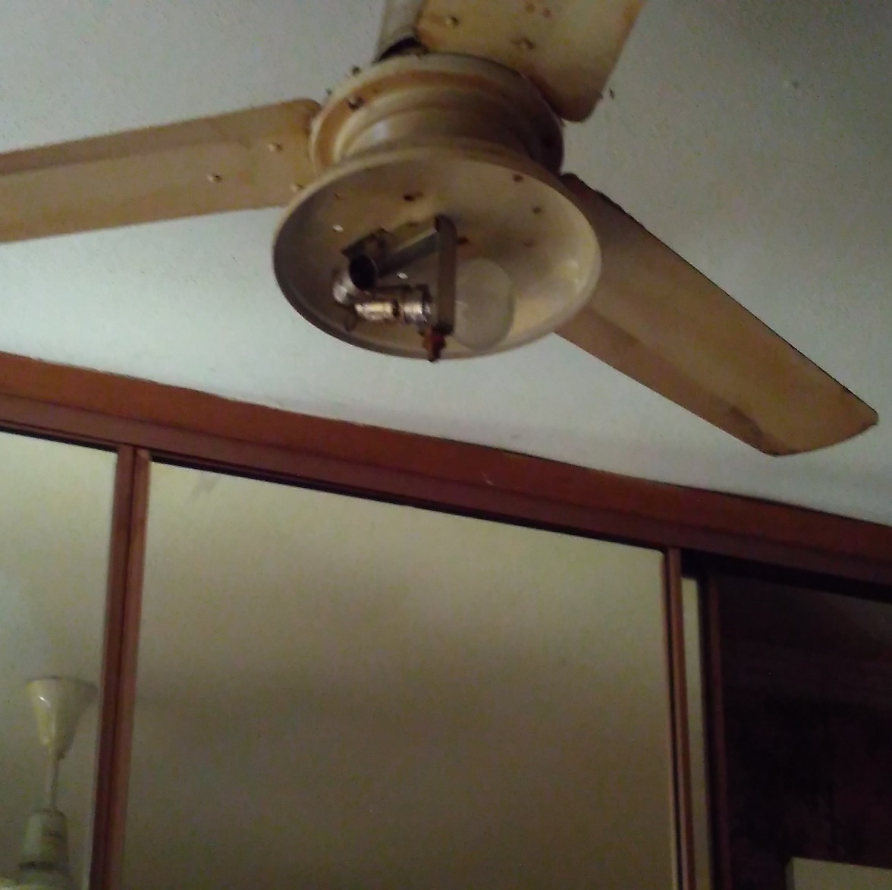
“Really dirty, did not have any amenities. staff were unhelpful. would not stay there again.”

Slide 4
“The landlord at the rooming house caused much trouble. she would open tenants rooms and go through personal belongings stealing valuables.
The house was dirty and unkempt.
i have never felt so used and abused in my whole life. “

Slide 5
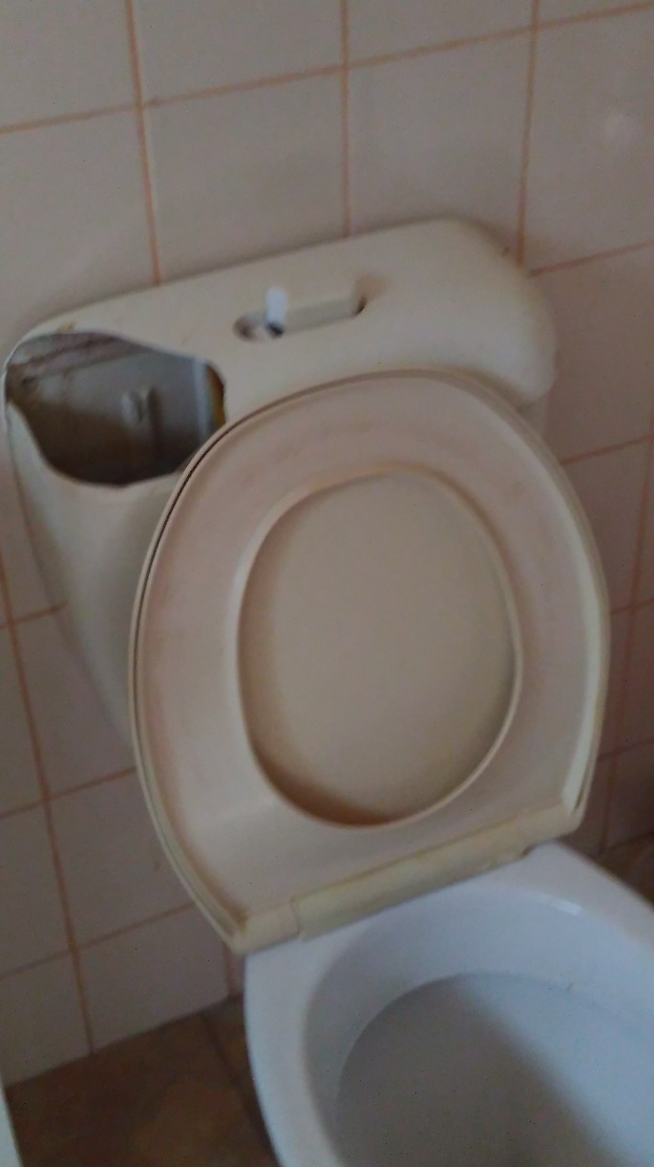
“Felt like no-one cared”

Slide 6
“you feel dirty and low and worthless when the place is dirty and no one is cleaning the place Should supply cleaning products ovens that work”

Slide 7
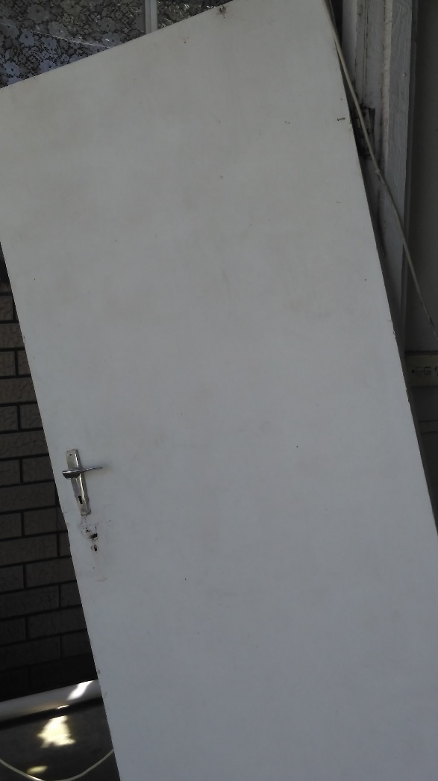
“Treated less than human”

Slide 8
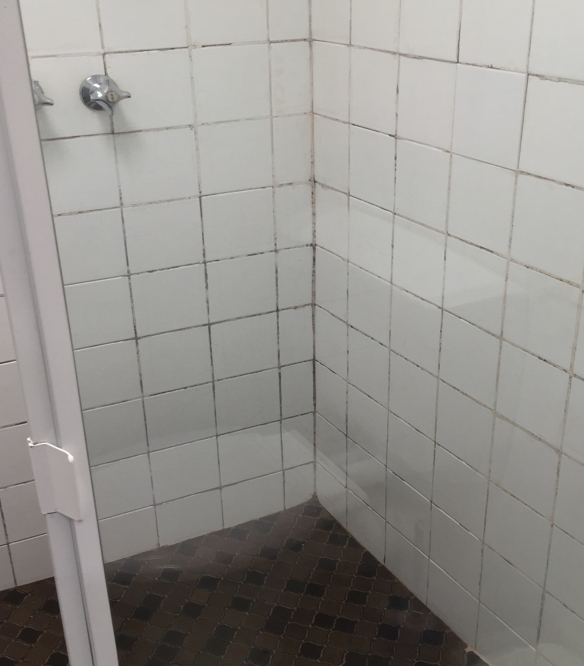
“really dirty, couldn't even have a shower”
“Rooming house felt scared unsafe”

Slide 9
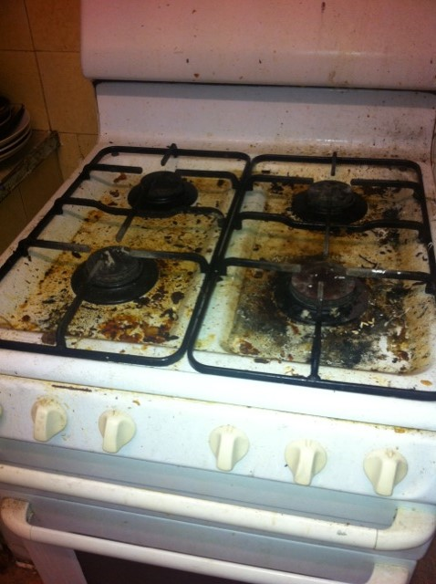
“I'd rather pitch a tent up north somewhere than take my child there”

Slide 10
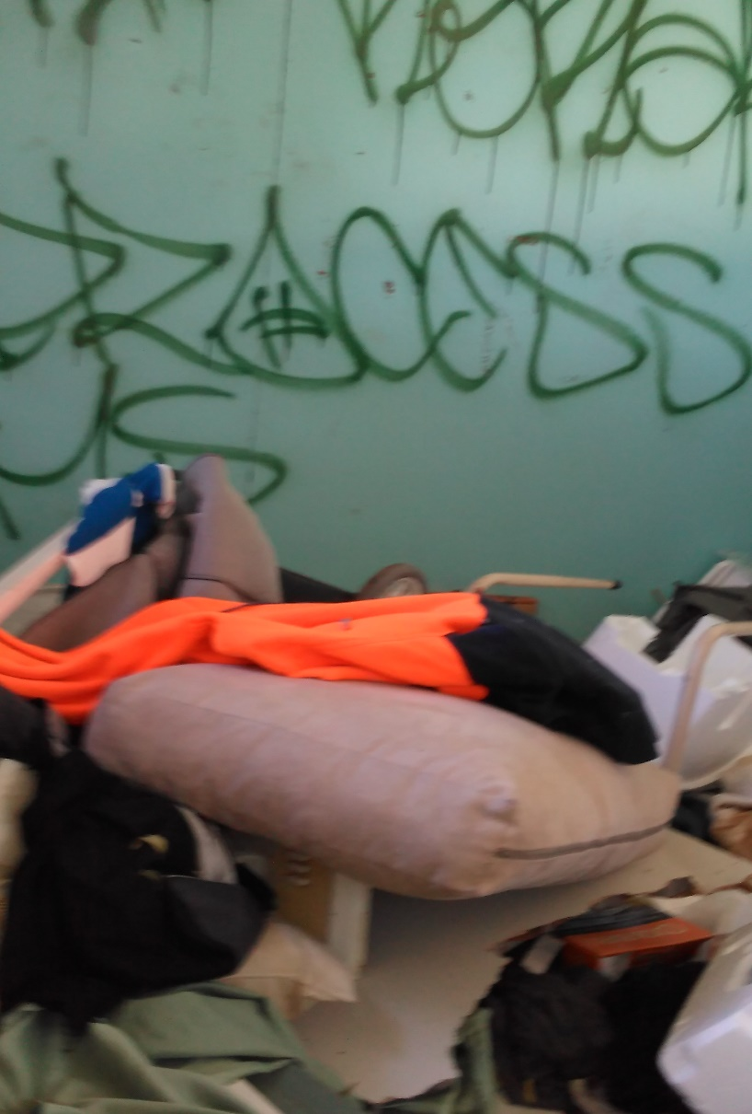
“don't put people into dodgy hotels” “it was putrid”

Slide 11
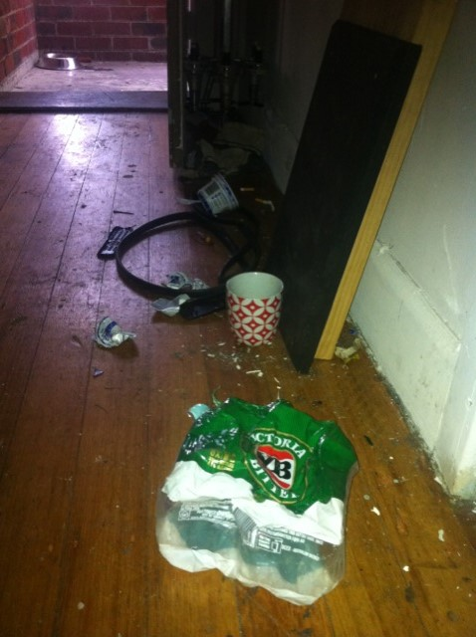
“halfway house for people who leave prisons, prostitutes, parties next door, drug users. I was terrified”

Slide 12
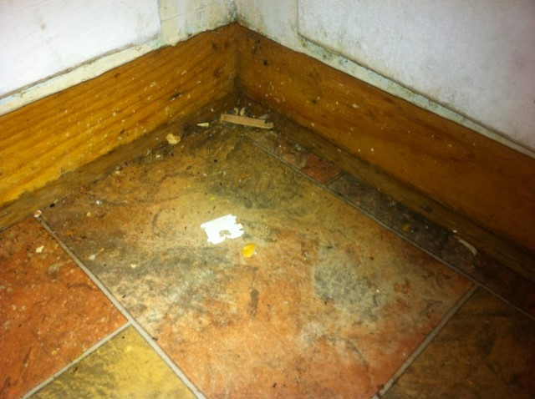
“I had a male person trying to open my room, had police knocking on my door looking for somebody at 4am”

Slide 13
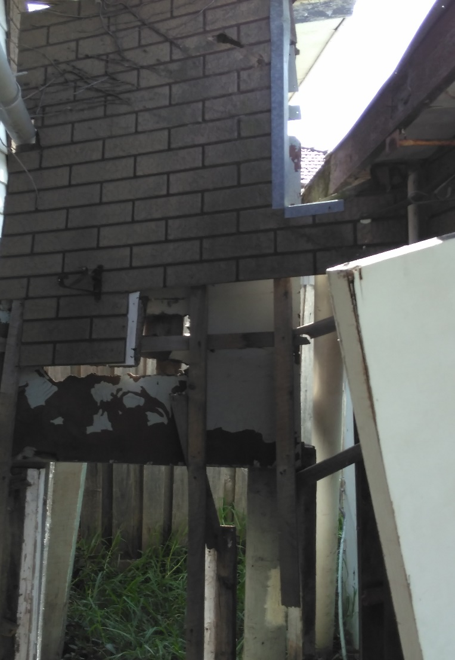
“Escaping DV. Preferred to stay in a car rather than a motel, a motel in XXX was very bad.”

Slide 14
What would make crisis accommodation better?
“Cleanliness, no bed bugs, safety, female only sections”
“a kitchen to cook food in”
“clean it and get rid of the dangerous people”
“proper locks on the doors”
“make it clean, private, cheaper”

Slide 15
What would make crisis accommodation better?
“make it more affordable for those with families in desperate need of a place to stay”
“More cleanliness, protection from bed bugs.”
“make them safe environment for children”
“not putting everyone randomly in one room recommend putting drug users/ addicts separately from non- drug users.”

